Slide 1
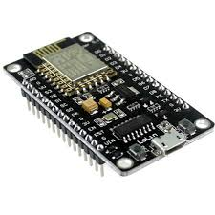
Intro to Architect of NODEMCU (ESP2866)

Slide 2
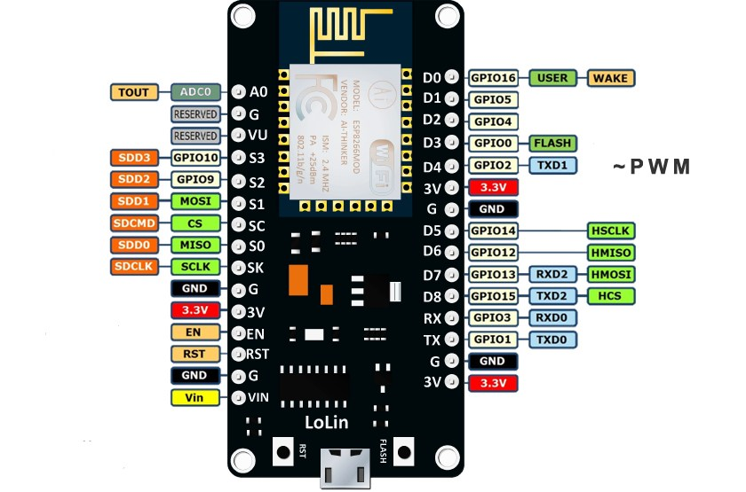
ARCHITECT of NODEMCU (PIN DIAGRAM)

Slide 3
FEATURES
Integrated low power 32-bit MCU
Integrated 10-bit ADC
Integrated TCP/IP protocol stack
Integrated PLL, regulators, and power management units
Supports antenna diversity
WiFi 2.4 GHz, support WPA/WPA2
Deep sleep power <10uA, Power down leakage current < 5uA
Wake up and transmit packets in < 2ms
Standby power consumption of < 1.0mW
+20 dBm output power in 802.11b mode
Operating temperature range -40C ~ 125C
FCC, CE, TELEC, WiFi Alliance, and SRRC certified

Slide 4
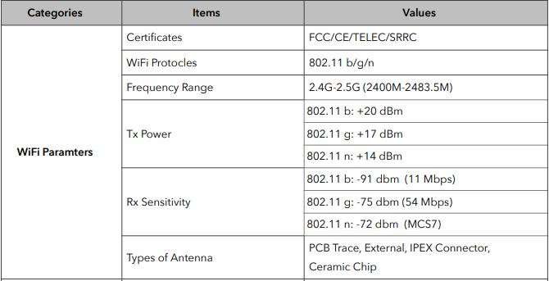

Slide 5
Advantages of NODEMCU
Ultra Power consumption Technique
By using advance power management techniques and logic to power-down functions not required and to control switching between sleep and active modes, ESP8266EX consumes about than 60uA in deep sleep mode (with RTC clock still running) and less than 1.0mA (DTIM=3) or less than 0.5mA (DTIM=10) to stay connected to the access point.
ESP8266EX is embedded with Tensilica L106 32-bit micro controller (MCU), which features extra low power consumption and 16-bit RSIC(Reduced Instruction Set Computing).
ESP8266EX WiFi SoC is embedded with memory controller, including SRAM and ROM.
RAM size < 36kB, up to 16 Mbyte memory capacity can be supported.

